Slide 1
JavaScript & Introduction to the DOM
Lesson 2.3

Slide 2
JavaScript Objects

Slide 3
Good Arrays

Slide 4
Joan of Arc (Bad Arrays)

Slide 5
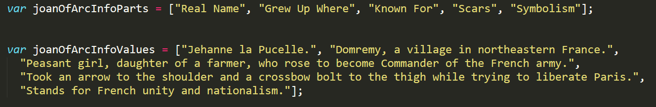
Associated Data ==/== Arrays
Relating two separate arrays is not fun.

Slide 6
Gandalf the Grey Objects

Slide 7
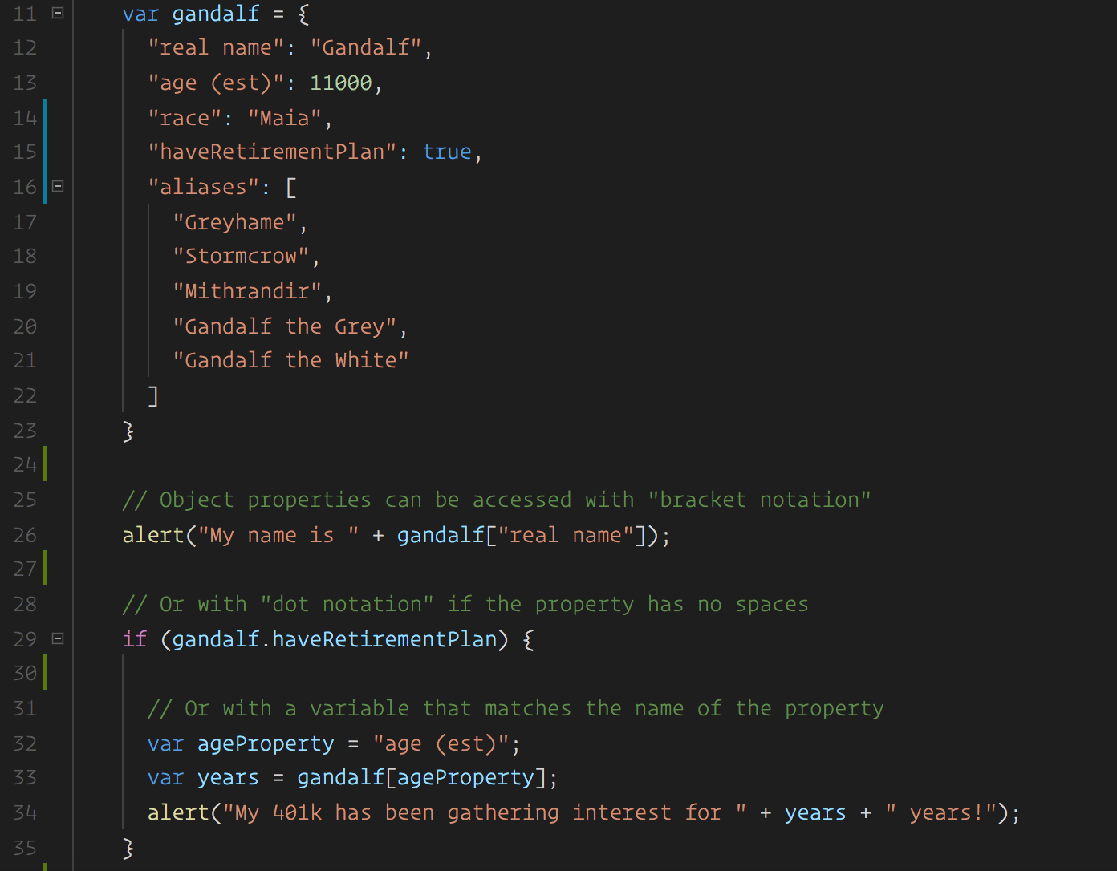
Gandalf: The Object
Gandalf’s properties and values are associated in object form, making it easy to recall specific data.

Slide 8

Objects Visualized
This is Gandalf. According to code, Gandalf is an object.
var gandalf | = | {
“real name” | : | “Gandalf” | ,
“age (est)” | : | 11000 | ,
“race” | : | “Maia”
}
Notes:
Image is from: shutterstock_1018526638

Slide 9
Objects Visualized
These are Gandalf’s properties (like descriptors).
var gandalf | = | {
“real name” | : | “Gandalf” | ,
“age (est)” | : | 11000 | ,
“race” | : | “Maia”
}
Notes:
Image is from: shutterstock_1018526638

Slide 10
Objects Visualized
These are the values of Gandalf’s properties.
var gandalf | = | {
“real name” | : | “Gandalf” | ,
“age (est)” | : | 11000 | ,
“race” | : | “Maia”
}
Notes:
Image is from: shutterstock_1018526638

Slide 11
Objects Visualized
Thus: gandalf[“race”] = “Maia
var gandalf | = | {
“real name” | : | “Gandalf” | ,
“age (est)” | : | 11000 | ,
“race” | : | “Maia”
}
Notes:
Image is from: shutterstock_1018526638

Slide 12
Gandalf: The Grey Objects (Repeat)

Slide 13
10 minutes
Group Activity (2 people): Basic Objects

Slide 14


Group Activity: Basic Objects
Suggested Time: 10 minutes
With a partner, spend the next few moments studying the code just slacked to you.
Then, write code below each comment to log the relevant information about the provided car object.
Bonus: If you finish early, create a brand new object of your own. Slack out a snippet of the code to the class when you are done. Be Creative!

Slide 15
Run That Car!

Slide 16
15 minutes
Challenge: Run That Car!

Slide 17
Challenge: Run That Car!
Suggested Time: 15 minutes
Using the code from the previous activity as a starting point, create a complete application such that:
Users can enter keyboard input (letters).
Each of the car's methods are assigned to a key.
When the user presses a key, it calls the appropriate function.
These letters also trigger a global function called rewriteStats() that logs the car's make, model, color, mileage, and isWorking status to the console.

Slide 20
Introduction to the DOM

Slide 21
What are the three building blocks of the web?

Slide 22



Building Blocks of the Web
HTML | CSS | JavaScript
Used to write content. | Used to format content. | Used to create dynamic web applications that take in user inputs, change what’s displayed to users, animate elements, and much more.

Slide 23
How (or where) do we connect all three?

Slide 24
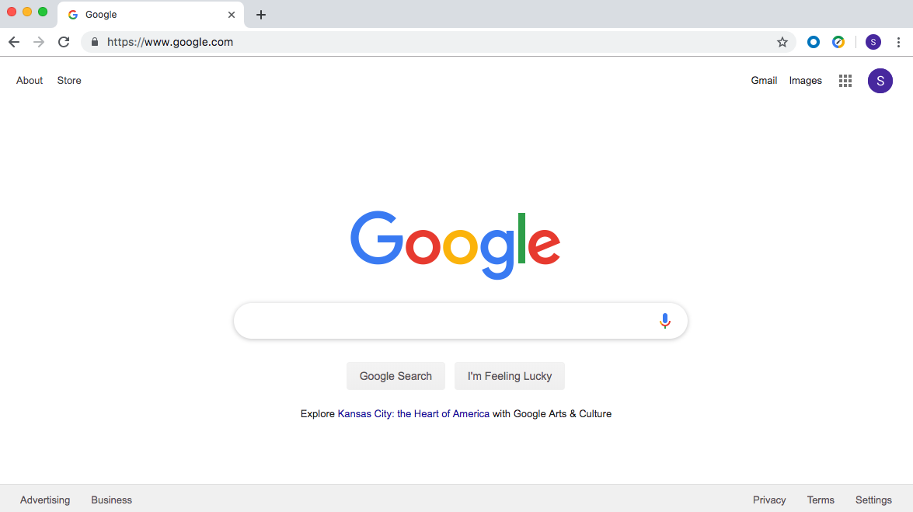
They Are Connected in the Web Browser
The browser brings together HTML, CSS, and JavaScript to create interactive webpages and applications.

Slide 25
What is a web browser?

Slide 26

A web browser, or browser, is a program used to access information on the World Wide Web. Every webpage, image, and video on the web can be accessed via a specific Unified Resource Link (URL). This lets browsers retrieve these resources from a web server and display them on a user's device.

Slide 27

What is an application programming interface (API)?

Slide 28
In web development, an API is a set of code features (methods, properties, events, and URLs) that developers can use in their apps to interact with components of a user's web browser, data sets, hardware/software on a user’s computer, or third-party software and services.

Slide 29
What are web APIs?

Slide 30

Web APIs
Web APIs are built into the web browser and contain methods that allow us to manipulate a webpage using JavaScript.
We can use web APIs to create elements and add them to the browser or to add and remove styles and attributes—all via JavaScript!

Slide 31
Activity: This Window
See instructions in 01-Stu_This-Window in the class repo.
In this activity, you will use console.log(this) and dig around inside the returned object, answering some questions along the way.
10 minutes

Slide 32
Activity: This Window
Instructions
First open the provided index.html file in the browser and navigate to the console.
What is logged?
The window object. In this use case, this refers to the window. The window is an object representation of an open window in a browser.
Click in the window object and begin looking at the numerous properties and methods it contains.
Make your way down to document and click in it.
Spend some time looking through the properties and methods in window.document.

Slide 33
What is window.document?

Slide 34

The Document Object Model (DOM)
The DOM is an object-oriented representation of HTML (i.e., the HTML document modeled as JavaScript objects).
Each element is a node.
Nodes are organized in a tree.
Notes:
The DOM represents the document so that its structure, style, and content can be changed via interaction with JavaScript. The DOM represents the document as objects and nodes. This representation allows for programmers to access the web API and modify the DOM.
When an HTML file is opened in a browser, the browser creates an object to represent the document and all of its containing elements.
With our HTML represented as objects, we can add, change or remove elements using JavaScript.
Each HTML element is referred to as a node.
The nodes are organized in a tree structure similar to the parent-child relationship of nested HTML elements.

Slide 35
What Is the Node Tree of This HTML?
<!DOCTYPE html>
<html lang="en">
<head>
<title>Document</title>
</head>
<body>
<div>Main div
<article>
<section>
</section>
</article>
</div>
<div>
<a href="myImg"></a>
<a href="secondImg"></a>
</div>
</body>
</html>
Notes:
<!DOCTYPE html>
<html lang="en">
<head>
<title>Document</title>
</head>
<body>
<div>Main div
<article>
<section>
</section>
</article>
</div>
<div>
<a href="myImg"></a>
<a href="secondImg"></a>
</div>
</body>
</html>

Slide 36
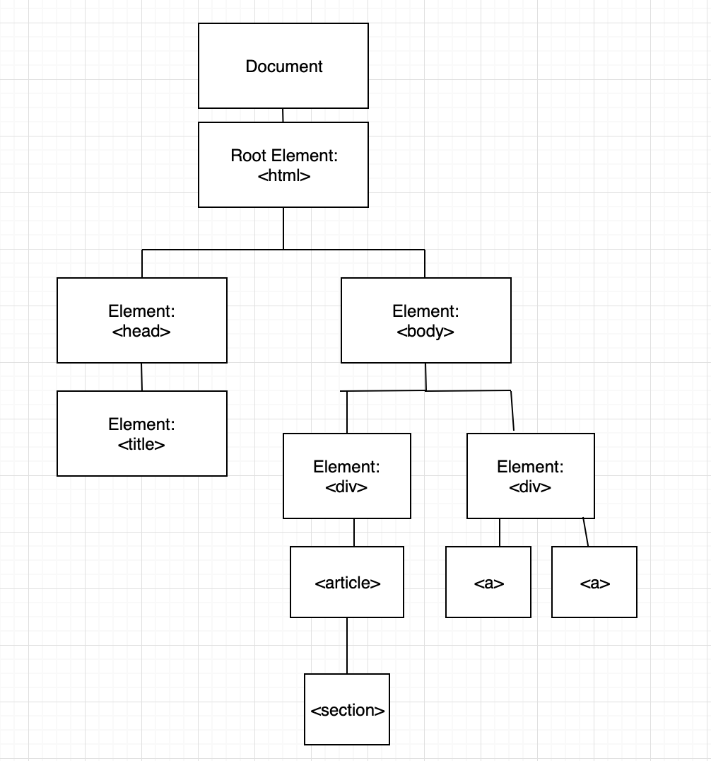
What Are the Parent, Child, and Sibling Nodes?

Slide 37
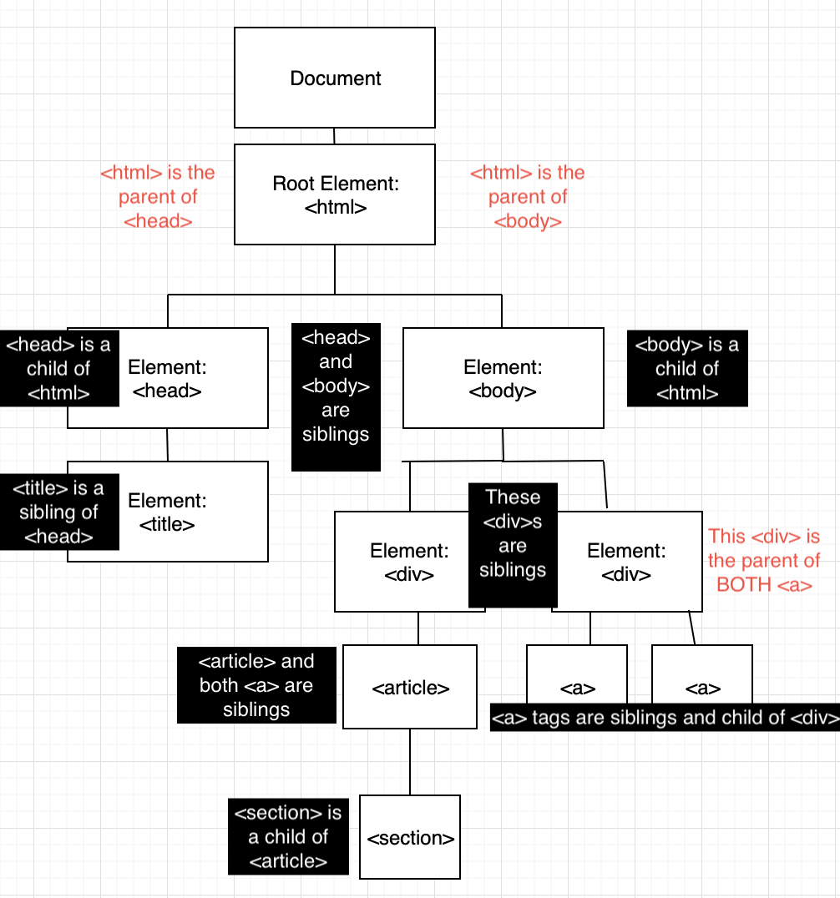
Node Relationships: Parents, Children, and Siblings

Slide 38
What is traversing the DOM?

Slide 39

DOM Traversal
Navigate to the MDN DOM Docs. Open the Chrome Dev Tools and enter the following commands one by one.
console.log(document.body);
console.log(document.body.children);
console.log(document.body.children[3]);
console.log(document.body.children[3].childNodes[7]);
console.log(document.body.children[3].childNodes[7].style.fontSize = "20px");
When using the style method, properties with two words (such as font-size) become a single word and camelCased. Font-size becomes fontSize.
Here is one more example of .style:
console.log(document.body.children[3].childNodes[7].parentElement.style.color = "red");

Slide 40

Our Goal Today
Navigate to the deployed Speed Reader app.
What do you not (yet!) know about how to build this application?
What do you think the steps are to build this application?

